Slide 1
Peripheral nerves and muscles upper limb

Slide 2
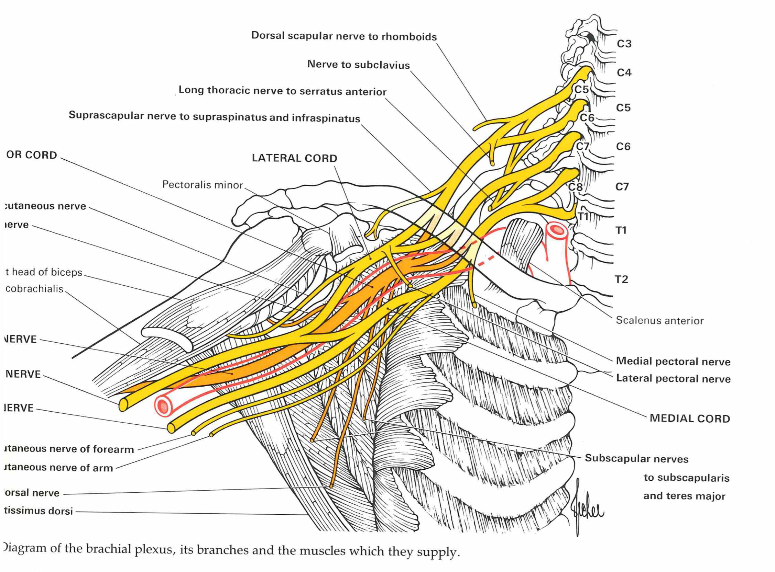

Slide 3
Trapezius (Spinal accessory nerve and C3,C4)
Notes:
Patient si elevating the shoulder against resistance. Arrow: the thick upper part of the muscle can be seen and felt

Slide 4
Serratus anterior (C5, C6, C7)

Slide 5
Rhomboids (dorsal scapular nerve; C4, C5)

Slide 6
Serratus anterior (C5, C6, C7)

Slide 7
Pectoralis Major: Clavicular Head (lateral pectoral nerve; C5, C6)
Notes:
The upper arm is above the horizontal and the patient is pushing forward aginst the examiner’s hand. Arrow: the clavicular head of pactoralis major can be seen and felt.

Slide 8
Pectoralis Major: sternocostal Head (lateral and medial pectoral nerves; C6, C7)

Slide 9
Supraspinatus (suprascapular nerve; C5, C6)
Notes:
Patient is abducting the upper arm against resistance. Arrow: the muscle belly can be felt and sometimes seen

Slide 10
Infraspinatus (suprascapular nerve; C5, C6)
Notes:
Patient is externally rotating the upper arm at the shoulder against resistance

Slide 11
Latissimus dorsi (thoracodorsal nerve; C6, C7, C8)
Notes:
The upper arm si horiwontal and the patients ia adducting it against resistance. Lower arrow: the muscle belly can be seen and felt. The upper arrow points to teres major

Slide 12
Teres major (C5, C6, C7)

Slide 13
Teres Major (subscapular nerve; C5, C6, C7)
Notes:
The patient is adducting the elevated upper arm against resistance. Arrow: the muscle belly can be seen and felt

Slide 14
Musculocutaneous nerve

Slide 15
Biceps (Musculocutaneous nerve; C5, C6)
Notes:
The patient is flexing the supinated forearm against resistance. Arrow: the muscle belly can be seen and felt.

Slide 16
Axillary and radial nerve

Slide 17
Deltoid (Axillary nerve; C5, C6)
Notes:
The patient is abducting the upper arm against resistance. Arrow: the anterior and middle fibers of the muscle can be seen and felt.

Slide 18
Triceps long head (C6, C7, C8)

Slide 19
Triceps (radial nerve; C6, C7, C8)
Notes:
The patient is extending the forearm at the elbow against resistance. The elbow is supported on a table. Arrows: the long and lateral heads of the muscle can be seen and felt

Slide 20
Brachioradialis (radialis; C5, C6)

Slide 21
Extensor carpi radialis longus (radial nerve, C5, C6)
Notes:
The patient is extending and abducting the hand at the wrist against resistance. Arrows: the muscel belly and tendon can be felt and usually seen

Slide 22
Supinator (Radial nerve; C6, C7)
Notes:
The patient is supinating the forearm against resistance with the forearm extended at the elbow

Slide 23
Extensor carpi ulnaris (posterior interosseus nerve; C7, C8)
Notes:
The patient is extending and adducting the hand at the wrist against resistance. Arrows: the muscle belly and the tendon can be seen and felt

Slide 24
Extensor digitorum (posterior interosseus nerve; C7, C8)

Slide 25
Abductor Pollicis longus (posterior interosseus nerve; C7 C8)
Notes:
The patient is abducting the thumb at the carpo-metacarpal joint in a plane at right angles to the palm. Arrow: the tendon can be seen and felt anterior and closely adjacent to the tendon of extensor pollicis brevis (cfr ext pollicis brevis)

Slide 26
Extensor pollicis longus (C7, C8)

Slide 27
Extensor pollicis brevis (posterior interosseus nerve; C7, C8)
Notes:
The patient is extending the thumb at the metacarpophalangeal joint against resistance. Arrow: the tendon can be seen and felt (cfr ext poll longus)

Slide 28
Median nerve

Slide 29
Pronator Teres (median nerve; C6, C7)
Notes:
The patient is pronating the forearm against resistance. Arrow: the muscle belly can be felt and sometimes seen.

Slide 30
Flexor carpi radialis (Median nerve; C6 C7)

Slide 31
Flexor digitorum superficialis (median nerve; C7, C8, T1)
Notes:
The patient is flexing the finger at the proximal interphalangeal joint against resistance with the proximal phalanx fixed. This test does not eliminate the possibility of flexion at the proximal interphalangeal joint being produced by flexor digitorum profundus.

Slide 32
Flexor digitorum profundus

Slide 33
Flexor pollicis longus (Anterior interosseus nerve; C7, C8)
Notes:
The patient is flexing the distal phalanx of the thumb against resistance while the proximal phalanx is fixed

Slide 35
Opponens pollicis (Median nerve; C8, T1)
Notes:
The patient is touching the base of the little finber with the thumb against resistance.

Slide 36
1st Lumbrical-Interosseus Muscle (Median and ulnar nerves; C8, T 1)
Notes:
The patient is extending the finger ar the proximal interphalangeal joint against resistance with the MCP joint hyperextended and fixed

Slide 37
Ulnar nerve

Slide 38
Flexor carpi ulnaris (ulnar nerve; C7, C8, T1)
Notes:
The patient is abducting the little finger against resistance. The tendon of flexor carpi ulnaris can be seen and felt (arrow) as the muscle comes into action to fix the pisiform bone from which abductor digiti minimi arises. If flexor carpi ulnaris is intact, the tenson is seen even when abducotr digiti minimi is paralysed.

Slide 39
Flexor carpi ulnaris (C7, C8, T1)
Notes:
Also seen is flexor carpi ulnaris

Slide 40
Flexor digitorum profundus III and IV (ulnar nerve; C7, C8)
Notes:
The patient is flexing the distal interphalangeal joint against resistance while the middle phalanx is fixed

Slide 41
Abductor digiti minimi

Slide 42
Flexor digiti minimi (ulnar nerve; C8, T1)
Notes:
The patient is flexing the little finger at the metacarpophalangeal joint against resistance with the interphalangeal joints held extended

Slide 44
Second palmar Interosseus muscle (ulnar nerve; C8, T1)
Notes:
The palm and fingers are flat upon a table. The patient is adducting the index finger against resistance.

Slide 45
Adductor pollicis en flexor pollicis brevis (median nerve, C8 T1)

Slide 46
Complete lesions of brachial plexus (C5, C6, C7, C8, T1)
Notes:
The approximate area within which sensory changes may be found in complete lesions of the brachial plexus

Slide 48
Axillary nerve
Notes:
Tne approximate area within which sensory changes may be found in lesions of the axillary nerve. Light touch, continuous line; pin-prick , dotted line

Slide 49
Radial nerve
Notes:
The approximate area within which sensory changes may be found in high lesions of the radial nerve (above the origin of the posterior cutaneous nerves of the arm and forearm). The average area is usually considerably smaller, and absence of sensory changes has been recorded

Slide 50
Radial nerve
Notes:
The approximate area within which sensory changes may be found in lesions of radial nerve

Slide 51
Musculocutaneous nerve
Notes:
The approximate area within which sensory changes may be found in lesions of the musculocutaneous nerve. The distribution of the lateral cutaneous nerve of the forearm.

Slide 52
Medial antebrachial cutaneous nerve

Slide 53
Median nerve
Notes:
Approximate area within which sensory changes may be found in lesions of the median nerve A: small area; B: average area; C: large area

Slide 54
Ulnar nerve
Notes:
Approximate area within which sensory changes may be found in lesions of the ulnar nerve A: small area, B: average area C: large area

Slide 55
Ulnar nerve below the origin of its dorsal branch
Notes:
The approximate area within which sensory changes may be found in lesions of the ulnar nerve below the origin of its dorsal branch. Light touch: continuous line; pinprick: dotted line

Slide 56
Dermatomes anterior aspect upper limb

Slide 57
Dermatomes posterior aspect upper limb

